Slide 1

Dr. Sajid Iqbal
Department of Computer Science
Bahauddin Zakariya University, Multan

Slide 2
Lecture Contents
Memory Hierarchy
CPU and Memory
Random Access Memory
Cache Memory
Hard Disk
Flash Memory
Solid State Disk

Slide 3
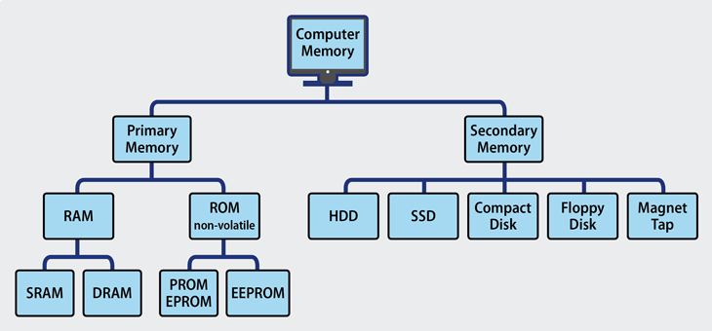

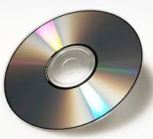
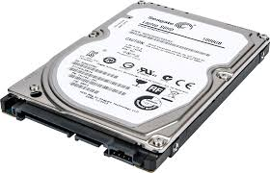

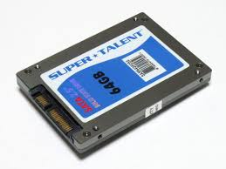
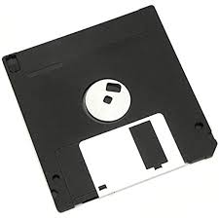
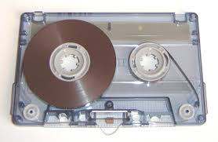
Memory Hierarchy
Primary Memory:
The memory which is installed within computer i.e. RAM, ROM
RAM is volatile whereas ROM is not
Secondary Memory:
This is permanent storage
It can be more in amount
It can be installed on mother board or can be connected using bus

Slide 4
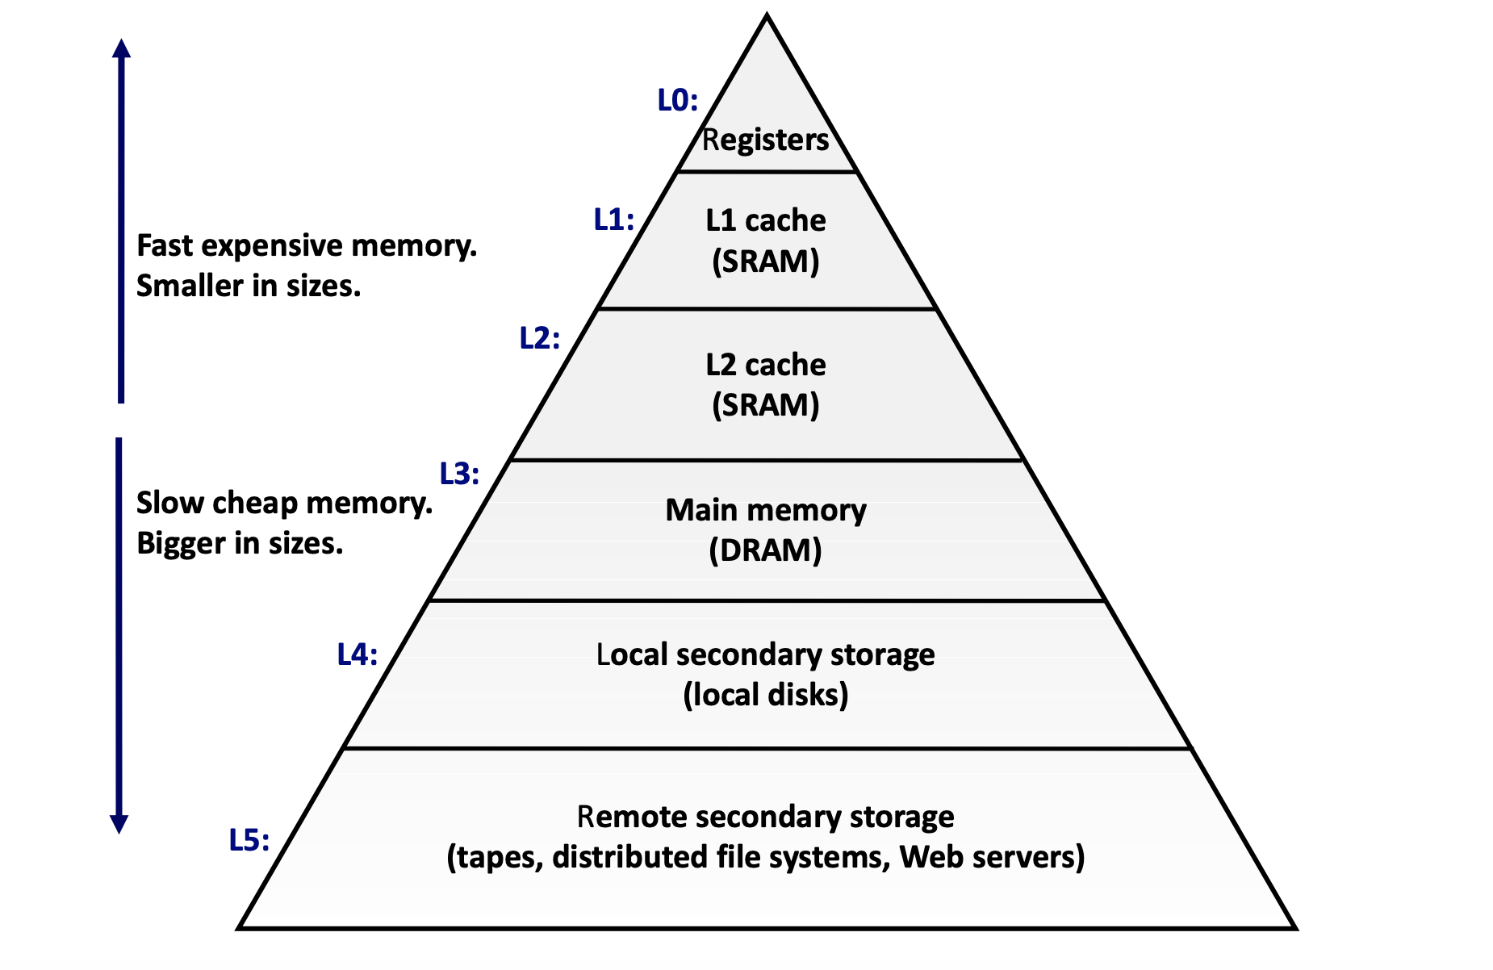

Slide 5
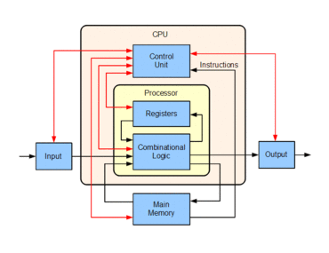
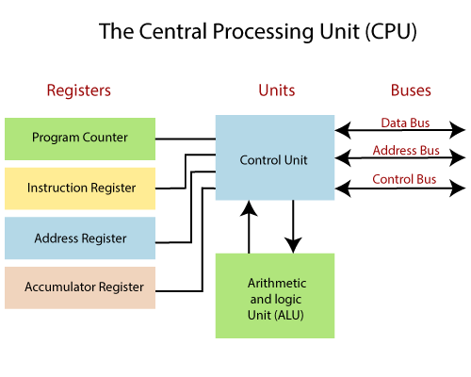
Memory in CPU
Registers
It is a quickly accessible location available to a computer's processor
These usually consist of a small amount of fast storage
Multiple functions:
Storing intermediate results
Storing next instruction and data
Address registers, data registers
Size: usually it is measured in no. of bits
8-bit register, 16,32,64,128 bit registers
Usually greater the register size, faster the processing

Slide 6
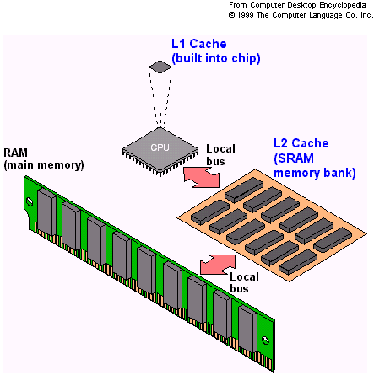
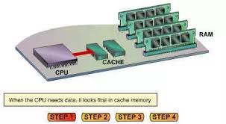
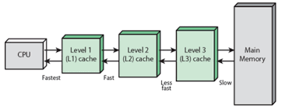
Cache Memory
It is small memory greater than registers size used to access data rapidly from memory
It which stores copies of the data from frequently used main memory locations
Most CPUs have different independent caches
Cache is of two type: instruction cache, data cache
The data cache is usually organized as a hierarchy of more cache levels (L1, L2, L3, L4, etc.)
Cache at nearest to CPU i.e. L1 Cache is smallest in size amongst all caches

Slide 7
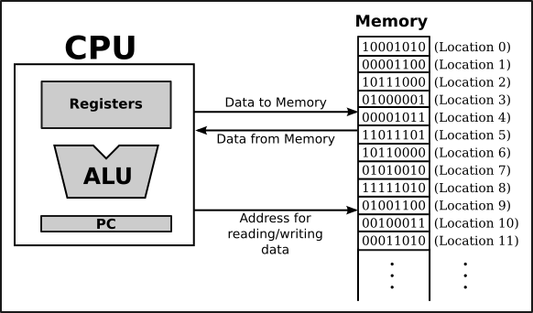
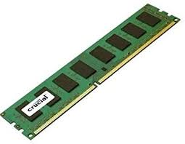
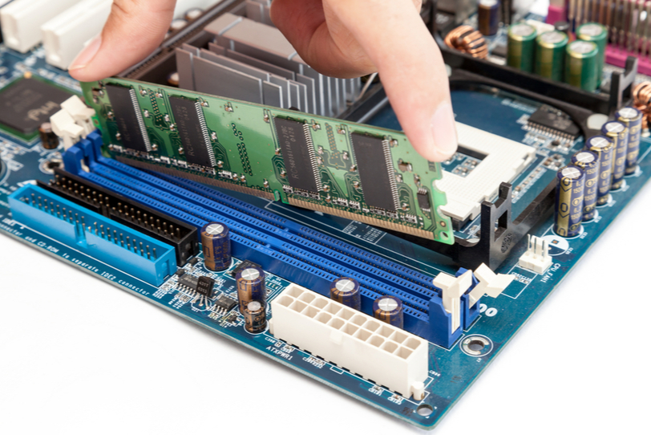
Random Access Memory (RAM)
Temporary storage of data (volatile)
When power is turned off, everything in RAM is turned off
RAM stores both code and data (temporarily)
When you open a picture in computer, it is loaded into RAM
Computations are done in processor by taking data and information from RAM and storing results back in RAM
Each group of 8-flip flops is known as byte
Each byte is numbered
The number of byte is called the address of byte

Slide 8
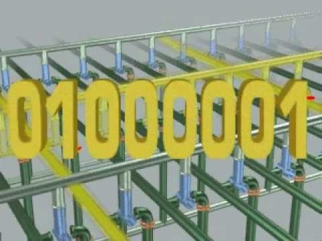

Working of RAM

Slide 9
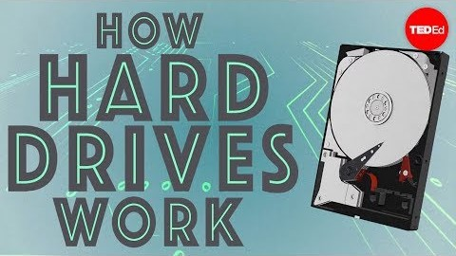
Persistent Storage Hard Disk
"Persistent" means preserved even when not powered on
Hard Drives: these have been the main, persistent storage tech for a long time
Thanks to YouTube video provider

Slide 10

Persistent Storage Flash Drive
A flash drive is solid state storage device which is fast, portable and small
It is non-volatile that can be erased and reprogrammed
Usually built using NAND and NOR gates
Normally data stored in Flash can be archived for one year
Thanks to the YouTube Video provider

Slide 11
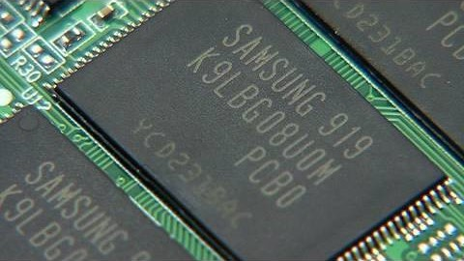
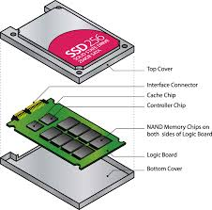
Persistent Storage Solid State Disk
A device that uses integrated circuit assemblies to store data persistently. Typically it uses Flash memory
Thanks to YouTube video provider

Slide 12
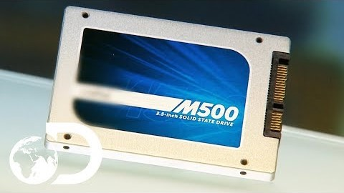
Persistent Storage Solid State Drives
Thanks to YouTube video provider

Slide 13



Thanks for watching
Dr. Sajid Iqbal
Assistant Professor
Department of Computer Science
Bahauddin Zakariya University, Multan
sajidiqbal.pk@gmail.com
https://github.com/sajjo79/Introduction-to-Computers
Allah Hafiz
COMEDXD

